Slide 1


What happens to Calls Recorded for “Quality Assurance”?
The Beauty and Joy of Computing Lecture #5 A Computer Science Research Field: Multimedia Computing
UC Berkeley EECS Lecturer Gerald Friedland
Audio Analysis tools do emotion and speech recognition in order to suggest solutions to the call center agent.
http://money.cnn.com/2014/09/15/technology/enterprise/att-customer-service/index.html

Slide 2
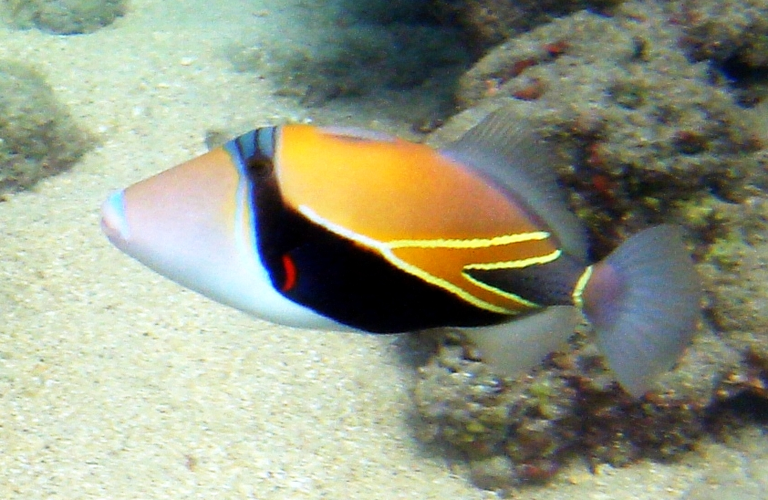
Recap: Abstraction
What’s this?
Photo: Qyd, Wikipedia
Abstraction: A fish
Detail: Humuhumunukunukuapua’a

Slide 3
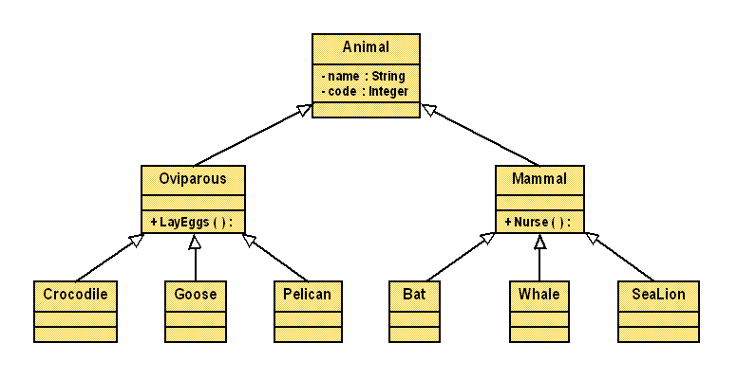
Recap: Object-Oriented Programming
Classes form a hierarchy through inheritance
The higher the class (superclass) in the hierarchy, the more abstract.
Inheritance saves code
Hierarchical classes
E.g., Bat special case of mammal, a special case of animal
Object is instance of class (embodiment in memory)
Many concrete bats flying around
http://www.ccs.neu.edu/research/demeter/personalities/luis/example/

Slide 4
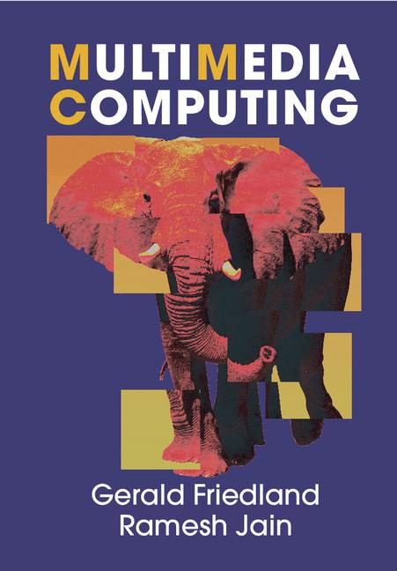
What is Multimedia Computing?
Multi: More than one
Media: (Digital) document created for human consumption
Multimedia Computing: Computing with documents created for human consumption
Text document with images
Videos
Research at ICSI
multimedia.icsi.berkeley.edu

Slide 5
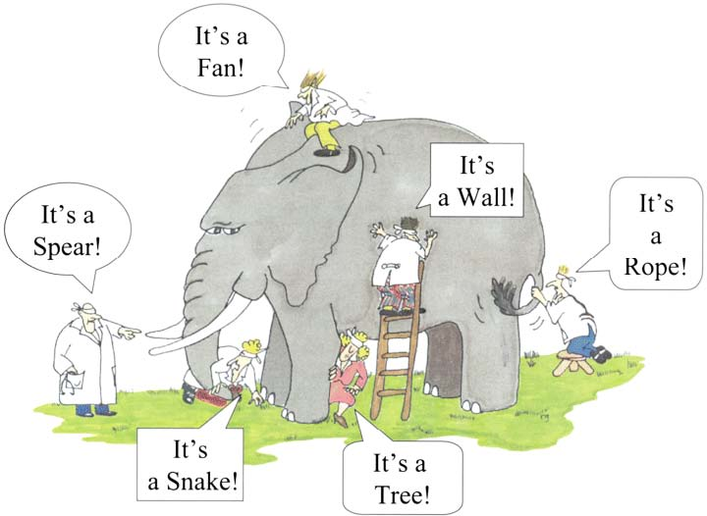
Holistic Approach
Documents are created, consumed, processed, and understood as a combination of media.
Otherwise: It’s like only looking at the images and not the text of a book.
Involves many disciplines: Computer Vision, Audio Analysis, Networking,…
G. Friedland, R. Jain: “Multimedia Computing”, Cambridge University Press, August 2014.

Slide 6
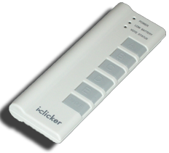
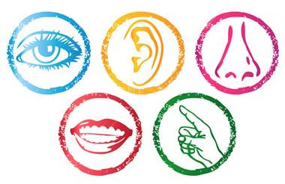
How many senses does a human have?
snap.berkeley.edu
1
2
3
5
More than 5
Image from: http://sblearninggarden.org/wp-content/uploads/2014/02/Exploring-the-5-Senses.pdf
Notes:
e) More than 5. The 5 plus: Proprioception, Temperature, balance, pain, etc…

Slide 7
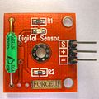
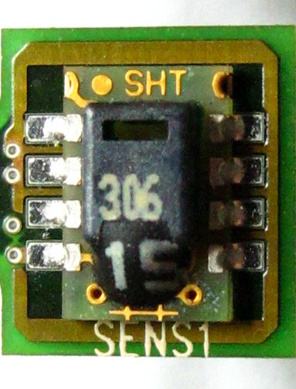
How many senses does a computer have?
snap.berkeley.edu
Computer can connect to sensors.
Sensors transform physical properties into numbers.
Hundreds of different types of sensors exists:
voltage, position, speed, radiation, temperature,…
Tilt Sensor Nevit Dilmen (Wikimedia Commons)
Humidity Sensor wdwd (Wikimedia Commons)
Notes:
e) More than 5. The 5 plus: Proprioception, Temperature, balance, etc…

Slide 8

Sensors for Multimedia Documents
snap.berkeley.edu
Documents are usually created using:
Text (keyboard)
Electronic Pens
Cameras
Microphones
Most documents, using a combination of them. Hence called Multimedia Documents
iPhone 6
Rayyuk (Wikimedia Commons)
Has 11 types of sensors!
Notes:
e) More than 5. The 5 plus: Proprioception, Temperature, balance, etc…

Slide 9
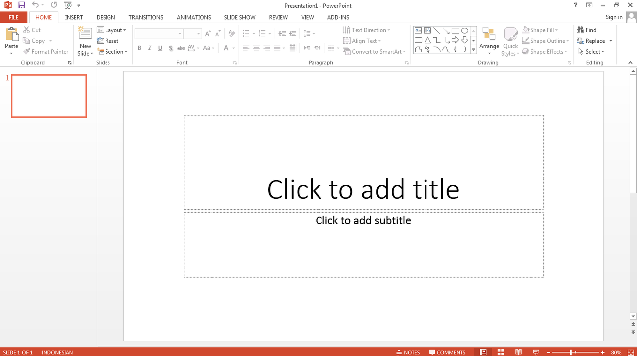
Multimedia Computing…
…is a research area that works on creating programs to help with the
Creation,
Processing
Analysis
Consumption
of multisensory documents.
"Microsoft PowerPoint 2013 Default Screen” Malikussaid Rayyuk (Wikimedia Commons)
Multimedia documents address several senses at once and therefore can be processed better by the brain!

Slide 10

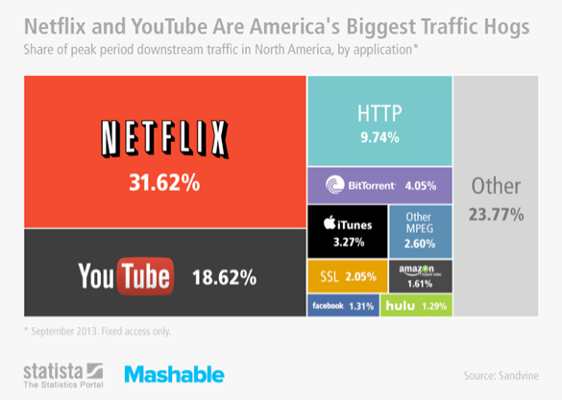
Example: Video Search
With more sensors -> More Multimedia Documents
YouTube receives 100 hours of video per minute!
Consumer-Produced Videos largest data source in the Internet. Larger than:
All webpages (text)
All emails ever written
Human genome
All professional videos
Today most of the traffic is videos!

Slide 11
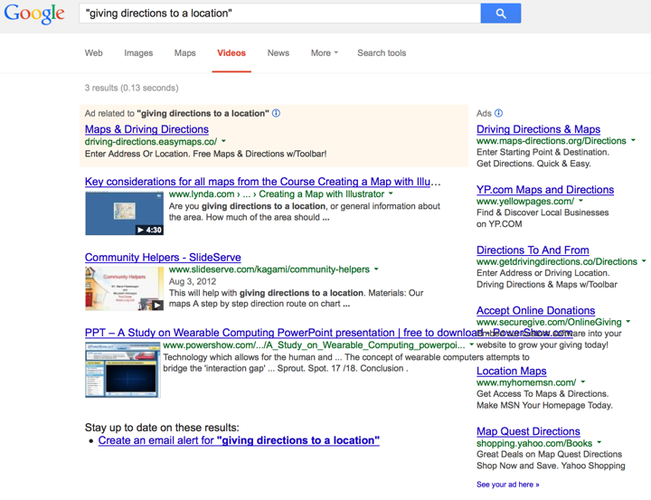
Example: Video Search Doesn’t Work!

Slide 12
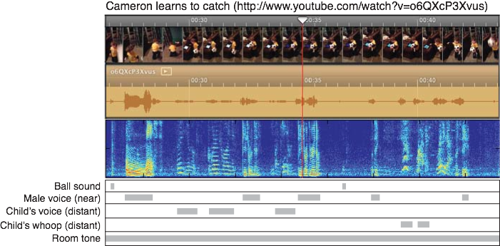
Video Search Using Audio Patterns
Research Performed at ICSI

Slide 13

Which city has this been recorded in?
Notes:
Solution: Tokyo. You hear the Shinkansen train. Tokyo has highest prior given the train noise and it’s correct. Therfore hig confidence for the computer using audio pattern recognition.

Slide 14
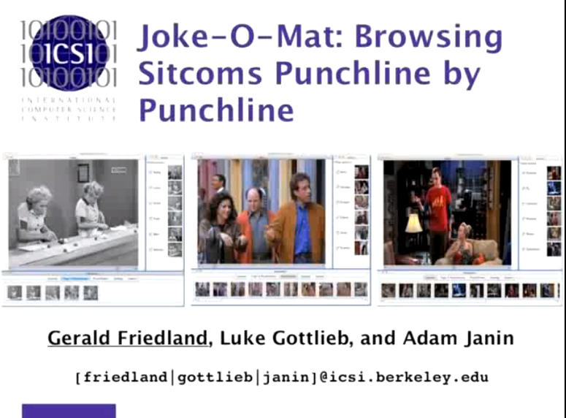
Example: Video Navigation
https://www.youtube.com/watch?v=1qfa84Ulm5s
Research Performed at ICSI

Slide 15

Summary
Multimedia.icsi.berkeley.edu
Beauty and Joy of Computing? You bet!
Multimedia documents convey Information better
Multimedia Computing is everywhere: We are creating and consuming documents on a day-to-day basis.
Interdisciplinary field!
Biggest Big Data!
Many future opportunities!
Send me email for a visit at ICSI!

